Slide 1

Displaying an IR Remote’s Information on an LCD
Arduino with C Programming
ELECTRICAL ENGINEERING AND COMPUTER SCIENCE, COLLEGE OF ENGINEERING AND PHYSICAL SCIENCES
Notes:
Updated 13 Jun 2024 by Noah Mulvaney

Slide 2

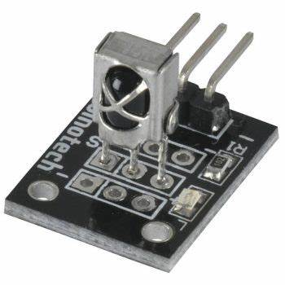
What is an IR Remote?
An IR (infrared) remote is a handheld device that sends commands to another device using infrared light
An IR receiver receives these commands, and the Arduino translates them
This allows us to control something else connected to the Arduino

Slide 3
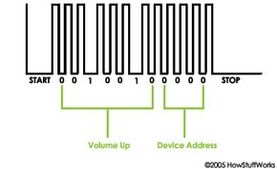
How does an IR remote work?
IR remotes send pulses of infrared light in different patterns to the IR receiver
The pattern is unique to the pressed button
These patterns are turned into electrical signals that the Arduino can comprehend
Once these patterns are translated, we can make this button do an action of choice

Slide 4
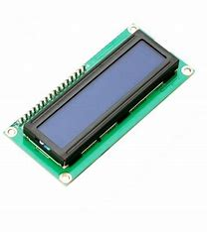
What is an LCD?
An LCD (liquid-crystal display) is a screen made of crystals that can control the amount of light that can pass through
When current is fed to these crystals they are physically manipulated to control light passage
This allows the LCD to display a wide variety of characters on the screen

Slide 5
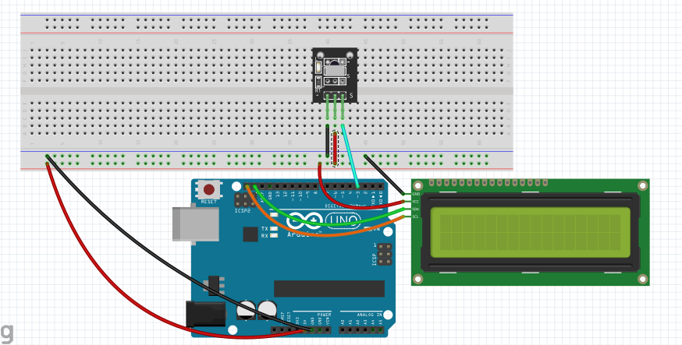
Circuit Diagram
Looking down on circuit, with IR receiver facing up.
SCL
SDA
Pin3
Has SDA and SCL pins. Not the one in your Arduino kit!

Slide 6
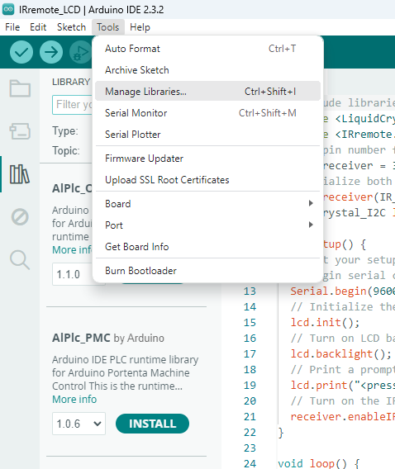
Installing Libraries
Click on ‘Tools’ at the top left
Locate ‘Manage Libraries…’ and click on it
Search ‘LiquidCrystal I2C’ and click install
Search ‘IRremote’ and click install
These are the libraries we need for the LCD screen, and the IR remote

Slide 7
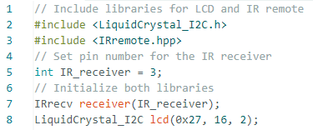
Completing the Code

Slide 8
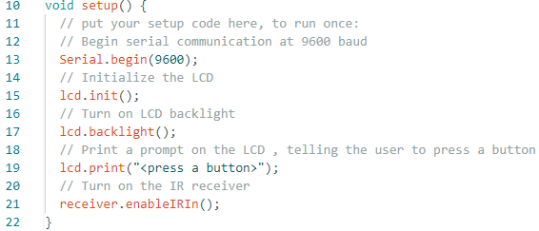
Completing the Code

Slide 9
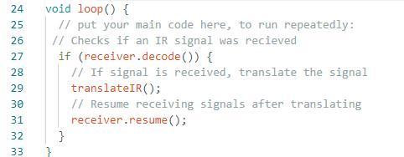
Completing the Code

Slide 10
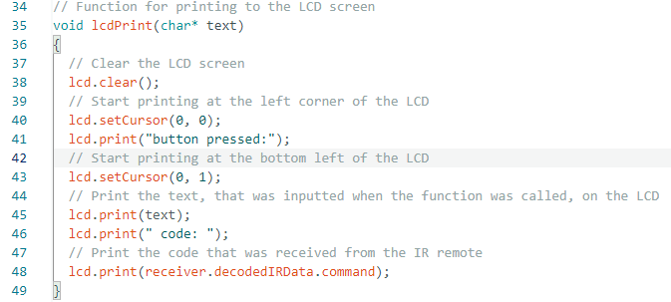
Completing the Code

Slide 11
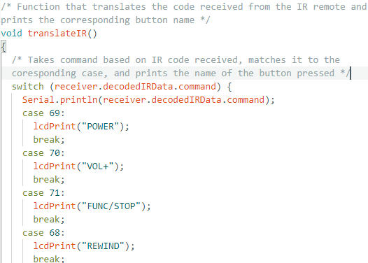
Completing the Code
This function is already completed for you
Run the program and see if the button name on the LCD matches the button you pressed
Notice that each button has a unique code linked to it

